Slide 1

Unemployment In different Countries Data Analysis
NAME:K.HEMALATHA
AF ID:AF0366906
GUIDE NAME:MANALI

Slide 2
ABSTRACT
This project looks at data about Unemployment in different Countries through year vise.Over the years from 1991 to 2021, we've looked at how unemployment rates have changed in various countries. By studying a big dataset covering this whole time span, we've found interesting patterns and differences in job availability worldwide. Using graphs and numbers, we've explored when unemployment went up or down and tried to figure out why. It's like taking a big picture of how job situations have evolved in different parts of the world over the last 30 years, helping us understand how economies and societies have been doing during that time.

Slide 3
Software Requirements:
Python:
Python is a programming language commonly used for data analysis and visualization. We will utilize Python for data manipulation, analysis, and visualization tasks.
Jupyter Notebook:
Jupyter Notebook is an interactive computing environment that allows for creating and sharing documents containing live code, equations, visualizations, and narrative text. It will be used for organizing and presenting the analysis in a structured manner.
Pandas:
Pandas is a powerful Python library for data manipulation and analysis. It provides data structures and functions to efficiently manipulate large datasets.

Slide 4
NumPy:
NumPy is a fundamental package for scientific computing in Python. It provides support for large, multi-dimensional arrays and matrices, along with a collection of mathematical functions to operate on these arrays.
Matplotlib:
Matplotlib is a plotting library for Python and NumPy. It enables the creation of static, animated, and interactive visualizations in Python. We will use Matplotlib to generate various types of plots and graphs to visualize the Unemployment data.

Slide 5
Advantages of the Project:
Economic Insights: Unemployment data provides valuable insights into the economic health of a country. High unemployment rates may indicate economic downturns, while low rates may signal economic growth.
Regional Comparisons: Comparing unemployment rates across countries can highlight differences in labor market policies, economic structures, and social welfare systems, leading to valuable lessons and best practices.
Social Impact: Unemployment data analysis can shed light on the social impact of joblessness, such as income inequality, poverty rates, and overall well-being of the population.
Education and Training: Understanding unemployment trends can help policymakers and educators develop programs to address skill gaps and improve workforce readiness.

Slide 6
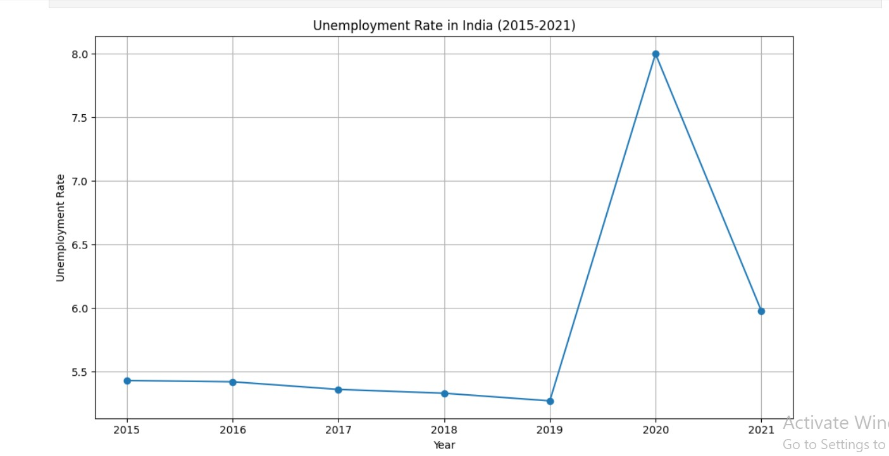
Unemployment in India from 2015 to 2021:

Slide 7
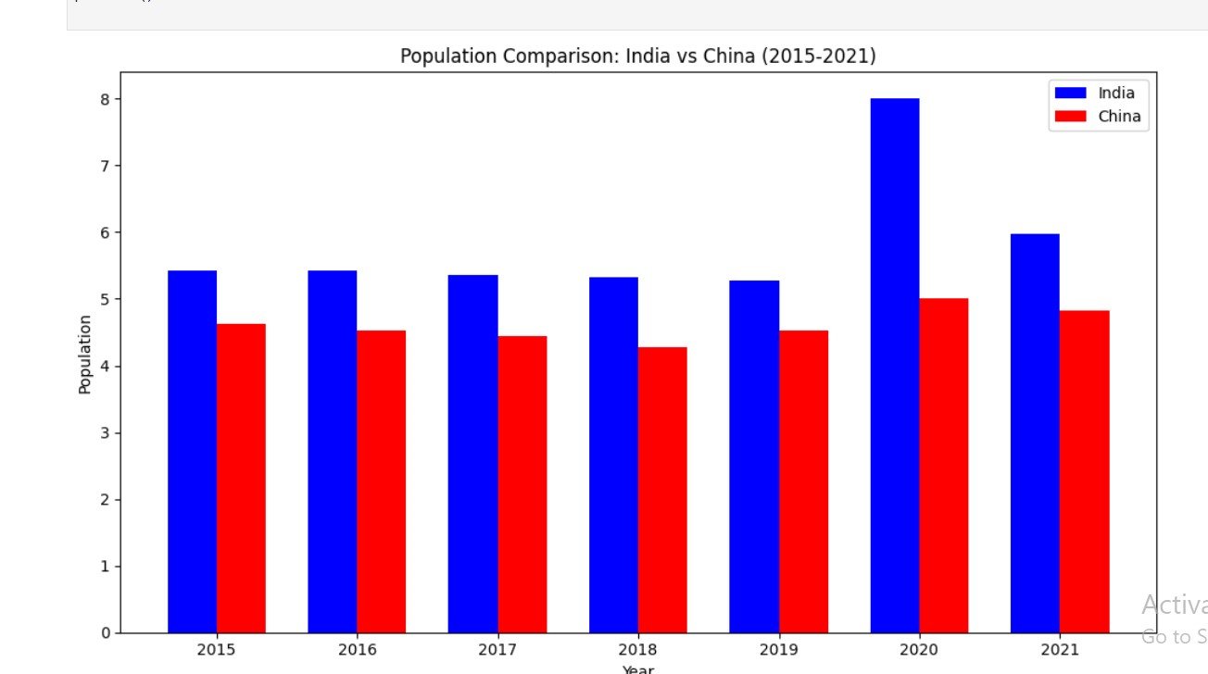
Unemployment Population Comparision between China and India:

Slide 8
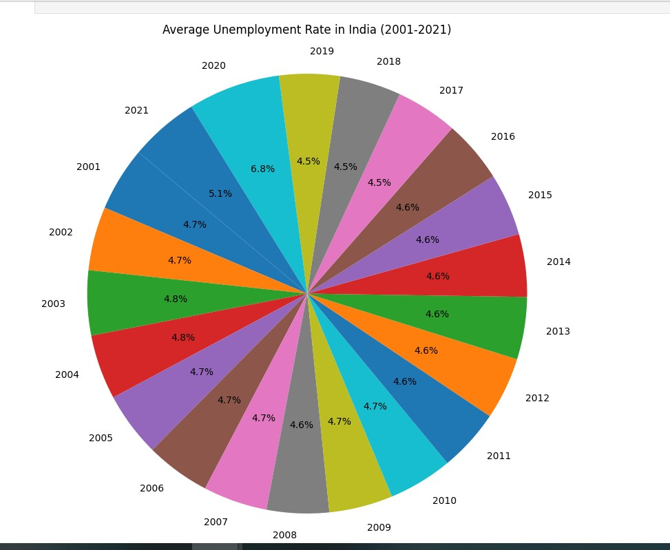
Average Unemployment In INDIA:

Slide 9
Countries with the highest unemployment rates in 1991:
Lesotho - 36.12
South Africa - 29.95
Djibouti - 29.36
Montenegro - 25.42
North Macedonia - 24.5

Slide 10
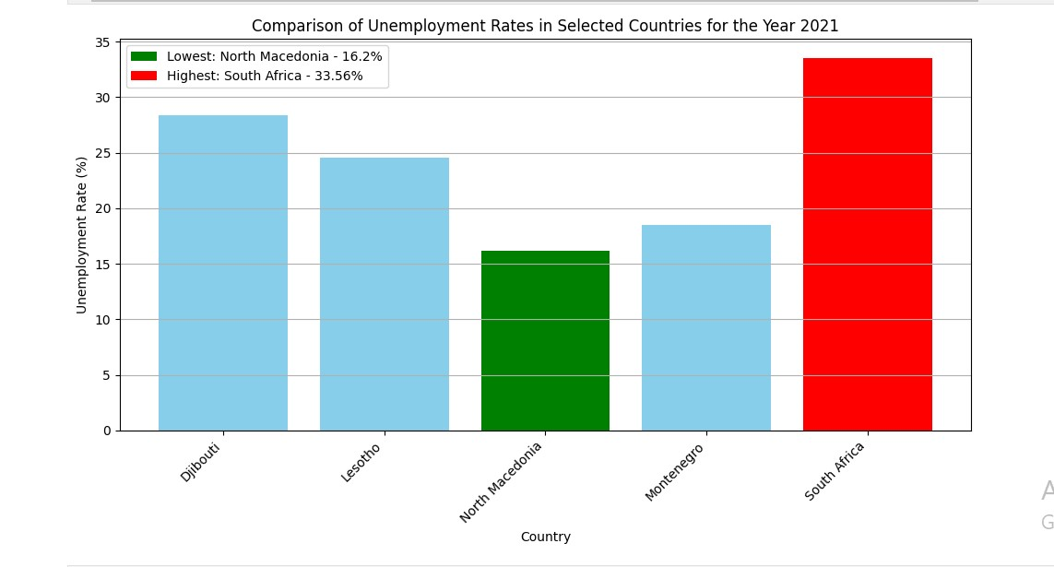

Slide 11
import pandas as pd
# Load the dataset containing unemployment rate data
df = pd.read_csv('https://raw.githubusercontent.com/HemalathaKoteru/Anudip_Project2/main/unemployment%20analysis11.csv')
# Print the column names to verify the structure of the dataset
print(df.columns)
Output:
Index(['Country Name', 'Country Code', 'Y-1991', 'Y-1992', 'Y-1993', 'Y-1994',
'Y-1995', 'Y-1996', 'Y-1997', 'Y-1998', 'Y-1999', 'Y-2000', 'Y-2001',
'Y-2002', 'Y-2003', 'Y-2004', 'Y-2005', 'Y-2006', 'Y-2007', 'Y-2008',
'Y-2009', 'Y-2010', 'Y-2011', 'Y-2012', 'Y-2013', 'Y-2014', 'Y-2015',
'Y-2016', 'Y-2017', 'Y-2018', 'Y-2019', 'Y-2020', 'Y-2021'],
dtype='object')

Slide 12
Future Enhancements
Regional Analysis: Expanding the analysis to examine unemployment trends at a more granular level, such as by region or city, to identify localized patterns and disparities.
Interactive Data Visualization: Developing interactive dashboards or visualization tools that allow policymakers, researchers, and the general public to explore and analyze unemployment data in a user-friendly manner.
Comparative Studies: Conducting comparative studies across countries or regions to benchmark unemployment rates, analyze policy effectiveness, and identify best practices for reducing unemployment.

Slide 13
Conclusion:
In conclusion, analyzing unemployment data provides valuable insights into the
dynamics of labor markets and their impact on societies and economies. Throughout
this analysis, we've explored various aspects of unemployment, including historical
trends, regional disparities, and demographic patterns. By examining unemployment
rates across different countries and time periods, we've gained a deeper understanding
of the factors influencing job availability and the effectiveness of policy interventions.

Slide 14
Thank You

